Slide 1
GitLab Overview
TekSystems Lunch & Learn
Dominic Tippabattuni

Slide 2
About me…
Software Developer
Work Interests
CloudNative Applications
DevOps
Secure Coding
3rd Presentation @ Tek Lunch & Learn

Slide 3
Topics covered…
Overview of GitLab features
GitLab for
Collaboration
Documentation
Planning
Source Code Management
CI/CD Pipelines

Slide 4
Topics Not Covered…
Implementation Details
GitLab for
Release Management
Configuration Management
Monitoring
Winning Presidential Elections!

Slide 5
Attendees…

Slide 6
GitLab Vision
Everyone can contribute to all digital content.

Slide 7
About GitLab
Started in 2011
Ruby on Rails application
Redis, PostgreSQL or MySQL
Supported Editions:
GitLab Community Edition (CE)
GitLab Enterprise Edition (EE)

Slide 8
About GitLab
GitLab Enterprise Edition (EE)
Starter LDAP/ AD Support, Configurable Issue Boards, Push Rules
Premium* Group Issue Boards, Audit Logs, Files Lock
Ultimate Epics, Static & Dynamic Application Security Testing
Web UI & GitLab API

Slide 9
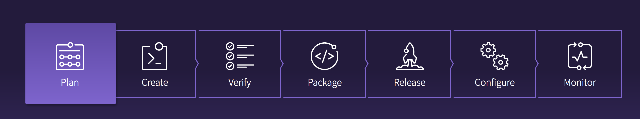
GitLab Features
From Planning to Monitoring
>70 features
https://about.gitlab.com/gitlab-com/

Slide 10
GitLab vs Other DevOps Tools…

Slide 11
GitLab Basics
Groups ( Team )
Projects
Repository
Issues
Settings / Permissions
Sub-Groups
Issues
Settings / Permissions / Memberships

Slide 12
GitLab Documentation Features
Wiki Pages
Markdown
Paragraphs, Headlines, Breaks, Lists
Image Links
GitLab Favored Markdown (GFM)
Emoji
Code and Syntax Highlighting
Tasks Lists
Mermaid (Diagrams and Flowcharts)

Slide 13

GitLab Plan Features
Issue Tracker
Milestones
Labels
Boards

Slide 14

Source Code Management
Project
Repository
Branches & Tags
Master Branch
Commits History
Fork
Merge

Slide 15
GitLab – SCM Commands
Git Command Line Interface
SSH Keys
Clone
Checkout
add - stage files, .gitignore
commit
push
Pull
Git IDE Plugin

Slide 16
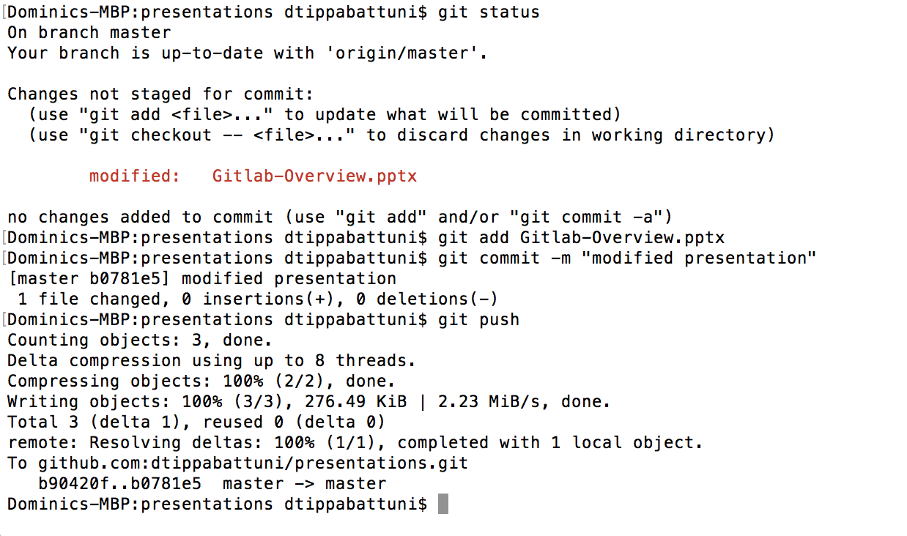
GitLab – SCM Commands

Slide 17
Simple Workflow

Slide 18
Git Flow Workflow

Slide 19
Workflow based on Environments

Slide 20
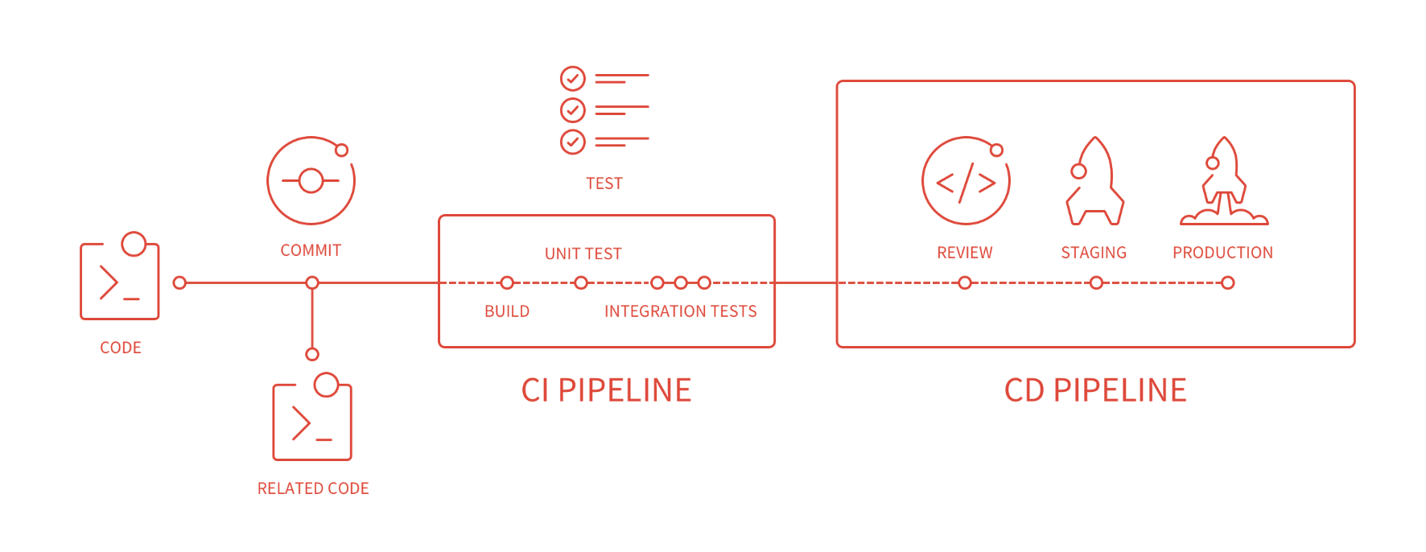
GitLab CI/CD

Slide 21
GitLab CI/CD

Slide 22
GitLab CI/CD
Jenkins GitLab Plugin
Jenkins Git Plugin
Jenkins Project Service

Slide 23
GitLab CI/CD
Enable CI/CD
.gitlab-ci.yml file
Stages
Jobs
Scripts
Cache
Git Runners – Specific & Shared Runners

Slide 24
DevOps Continuum

Slide 25
Overall Thoughts!
Great for SCM!
Includes all features needed for Product Development
Every task is an Issue?
Feature Creep!

Slide 26
Questions?

Slide 27
Thank You !!!

Slide 28
References
https://about.gitlab.com
https://www.versionone.com/devops-101/what-is-devops
https://github.com/adam-p/markdown-here/wiki/Markdown-Cheatsheet

